Slide 1
Sampling on Imbalanced Data

Slide 2
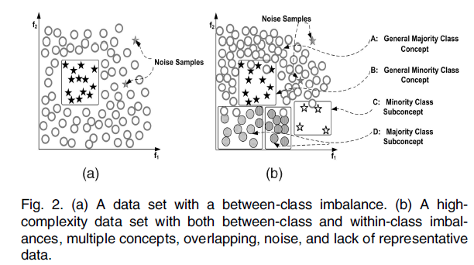
Rare vs. Within-Class Imbalance
Studies show that balanced datasets provide improved overall classification performance.

Slide 3
Sampling Methods
Random Oversampling & Undersampling
Informed Undersampling
Synthetic Sampling with Data Generation
Adaptive Synthetic Sampling
Sampling with Data Cleaning Techniques
Cluster-based Sampling Methods
Integration of Sampling and Boosting

Slide 4
Random Oversampling & Undersampling
Random Oversampling: randomly replicate minority samples, leading to overfitting;
Random Undersampling: randomly remove majority samples, leading to concept loss.

Slide 5
Informed Undersampling
Overcome the deficiency of information loss introduced in random undersampling.
Easy Ensemble
Balance Cascade
KNN-Undersampling

Slide 6
Informed Undersampling
Easy Ensemble: independently random sampling with replacement from majority + build multiple classifiers with minority (like Bagging放回采样)
Balance Cascade: ensemble classifiers + correctly classified majority sampling set is removed in the next sampling. (like Boosting对正确分类不放回，错误放回采样)

Slide 7
Informed Undersampling
KNN-Undersampling: select majority samples whose average distance(设计到距离一定要先做标准化，然后对一些比较少的特征点做feature selection)
Near Miss-1: to the three closest minority samples is the smallest;
Near Miss-2: : to the three fathest minority samples is the smallest;
Near Miss-3: select a given number of closest (surrounding) majority samples for each minority sample;
Most Distance: to the three closest minority samples is the largest.

Slide 8
Synthetic Sampling with Data Generation
SMOTE: Synthetic Minority Oversampling Technique
Create new minority samples based on feature space similarities between existing minority samples.
Randomly select one of the KNN(minority class) of a minority sample , , enlarge its feature vector with a random number between[0,1] in the way:

Slide 9
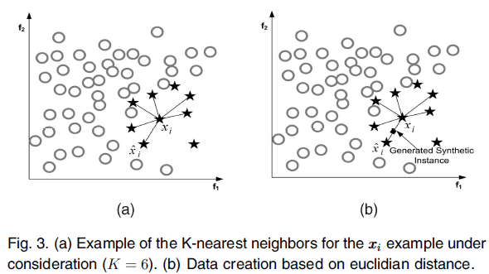
SMOTE: Example

Slide 10
SMOTE（分析优缺点）
Avoid overfitting introduced by random oversampling;
Augment minority samples in a manner that generally significantly improves learning;
Drawback: Over generalization—generate same number of synthetic samples for each minority sample without considering neighboring samples, increasing chances of overlapping between classes.（对少数派样本平等，增加分界线相当于对不在河岸边的样本点里面增加噪音点，反而更加不准确）

Slide 11
Adaptive Synthetic Sampling
Overcome SMOTE limitation by considering neighborhood.
Border-line-SMOTE: only generate synthetic samples for those minority samples “closer” to the border.（在分界线边的少数派生成样本）
Adaptive Synthetic Sampling (ADA-SYN): adaptively create different amounts of synthetic samples according to original sample distribution. Bordering minority samples would have more synthetic ones.（根据distribution分布密集度考虑增长多少个样本，在分界线边增加更多）

Slide 12
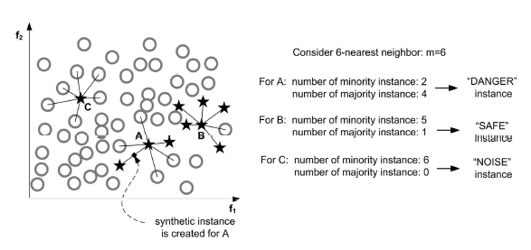
Border-line-SMOTE
Only Danger Set is fed to SMOTE to generate synthetic minority samples.
Danger Set: have more majority neighbors than minority ones; likely to be misclassified.（C作为噪音删除，B不容易分错，A又是少数派容易分错，可以认为A在分界线上，因此为A增加一些样本）

Slide 13


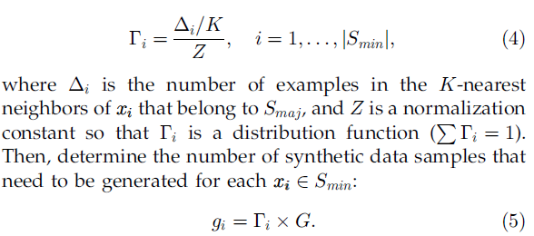
ADASYN
Calculate Synthetic Amounts:
is a parameter used to specify the desired balance level;（衡量平衡级别）
Use a density distribution to automatically decide the number of samples to be generated for each minority sample.
Find KNNs and calculate the density distribution ratio:
（缺点：对一个兄弟节点反而给了最大量的增长，假如点是噪音点的话会让准确度受到很大的影响，噪音点去除不出来，认为每个样本都重要）

Slide 14
Sampling with Data Cleaning
增加少数派的风险：可能会引入噪音，让分界线模糊，假如一开始做增加样本，后面可以适当加入做减少样本方法，做算法设计可以一开始做加法后面几步可以加入减法
Tomek Link: a pair of minimally distanced neighbors of opposite classes.
If two samples form a Tomek link, then either one of them is noise or both are near a border.
Use Tomek links to “clean up” unwanted overlapping between classes after synthetic sampling.
Remove all Tomek links until all minimally distanced nearest neighbor pairs are of the same class.

Slide 15
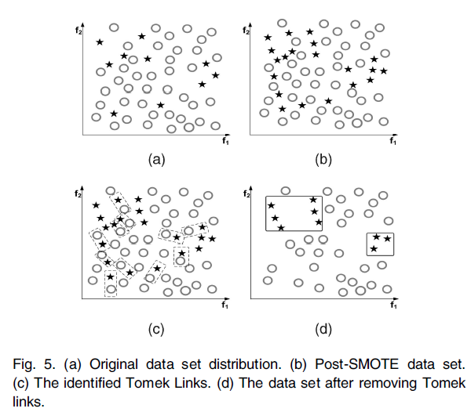
SMOTE+Tomek Cleaning
Well-defined class
clusters lead to improved classification
performance.
少数派样本不是越多越好，好的少数派样本才对分类器有作用。数据的增添减少采样都是为了找出更准确的样本使得分类器更加准确。
可以考虑采样要不要先对数据进行清洗，不要把所有数据都喂给分类器，考虑分界线边的样本。

Slide 16
Cluster-based Sampling(类内不平衡，多数派中有多个亚型)
CBO: Clustering-based Oversampling（主要解决内部不平衡）
K-Mean +Within-Class Balancing+Between-Class Balancing
Takes a random set of K samples from each cluster (for both classes) and computes the mean feature vector as the cluster center;
The remaining training samples are employed to optimized cluster centers;
Enlarge all majority class clusters to the same size as the largest;
Enlarge all minority clusters to the same size, with total sample numbers of all minority clusters equal to those of all majority clusters.
从每个聚类中随机抽取一组K个样本（对于两个类），计算平均特征向量作为聚类中心；
剩余的训练样本用于优化聚类中心；
将所有大多数类聚类扩大到与最大类相同的大小；
将所有少数类聚类扩大到相同的大小，样本总数为所有少数群体的数量等于所有多数群体的数量。

Slide 17
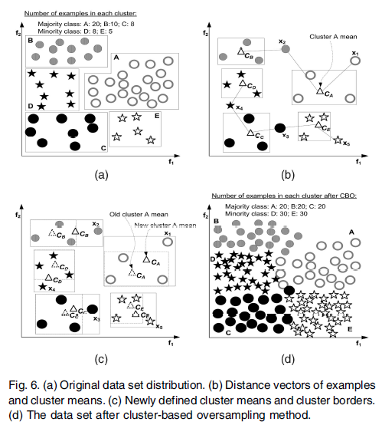
CBO: Example

Slide 18
Integration of Sampling and Boosting
SMOTEBoost: for each boosting iteration, employ synthetic sampling for minority class; focus more on minority.（对每一轮的boosting对分错的加权重，对少数派增持合成，跟多数派合并）（弊端：只关注少数派，有的多数派也会被分错，分界线边的多数派可能会被分错，但是算法却不会关注它们）
DataBoost-IM: generate synthetic samples according to the ratio of difficult-to-learn samples between classes; achieve high predictive accuracy for minority without sacrificing the accuracy for majority.（关注容易被分错的样本，对它们进行增持，因此即关注少数派，又不牺牲多数派的准确率）
JOUS-Boost: use duplicate samples from random oversampling and introduce perturbations for each boosting iteration; thus simple and computationally cheaper than synthetic methods.（训练时间本来就长，因此需要提升算法效率。简单拷贝下样本，但是容易过拟合，因此加入一些小的改变，保证计算速度快）

Slide 19


Q&A
Notes:
http://chalkpaperscissors.com

